Slide 1
Empirical Asset Pricing via Machine Learning
Notes:
难度怎么看：回归太简单，实证金融，中介变量，工具变量，门限回归，机器学习要对模型有一点改进。
创新点：重点不是放在模型的比较上，研究低价股效应，讲故事。

Slide 2
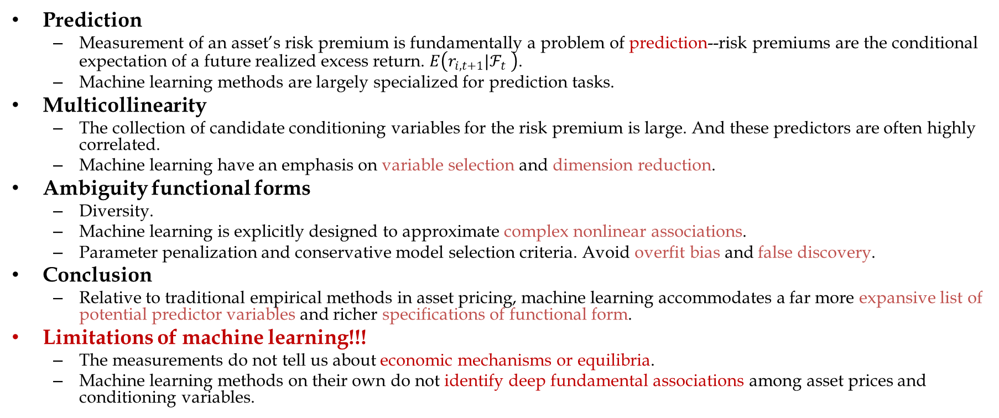
Motivation: why machine learning?
Prediction
Measurement of an asset’s risk premium is fundamentally a problem of prediction--risk premiums are the conditional expectation of a future realized excess return. $E\left(r_{i,t+1}|ℱ_{t} \right)$.
Machine learning methods are largely specialized for prediction tasks.
Multicollinearity
The collection of candidate conditioning variables for the risk premium is large. And these predictors are often highly correlated.
Machine learning have an emphasis on variable selection and dimension reduction.
Ambiguity functional forms
Diversity.
Machine learning is explicitly designed to approximate complex nonlinear associations.
Parameter penalization and conservative model selection criteria. Avoid overfit bias and false discovery.
Conclusion
Relative to traditional empirical methods in asset pricing, machine learning accommodates a far more expansive list of potential predictor variables and richer specifications of functional form.
Limitations of machine learning!!!
The measurements do not tell us about economic mechanisms or equilibria.
Machine learning methods on their own do not identify deep fundamental associations among asset prices and conditioning variables.
Notes:
风险溢价本身是一个预测问题，因为风险溢价就是对未来超额收益的条件期望。
传统的实证方法在预测风险溢价时比较吃亏。
多重共线性问题：传统失效，机器学习有效；
风险溢价的函数形式是模糊的：传统方法失效，而机器学习提供了很多规范的算法。多样性、复杂的非线性、惩罚机制避免过拟合。
机器学习本身非常适用于预测问题，相比于传统计量方法可以容纳更多的features，也有更多规范的算法。
现阶段，市场上有很多风险溢价因子，且它们是高度相关的。这时，传统的预测方法会由于多重共线性而失效。而机器学习侧重变量选择和降维。

Slide 3
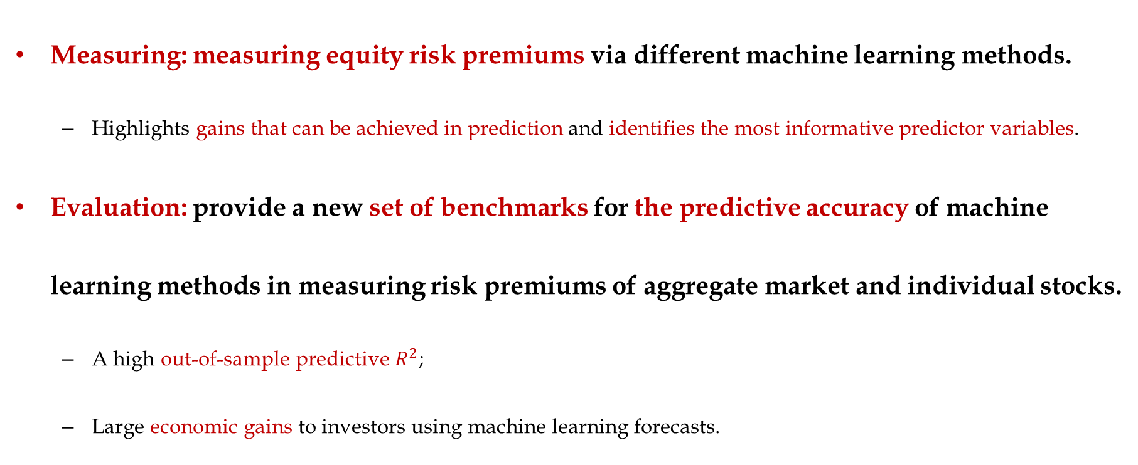
Main work: traditional methods VS machine learning
Measuring: measuring equity risk premiums via different machine learning methods.
Highlights gains that can be achieved in prediction and identifies the most informative predictor variables.
Evaluation: provide a new set of benchmarks for the predictive accuracy of machine learning methods in measuring risk premiums of aggregate market and individual stocks.
A high out-of-sample predictive $R^{2}$;
Large economic gains to investors using machine learning forecasts.

Slide 4
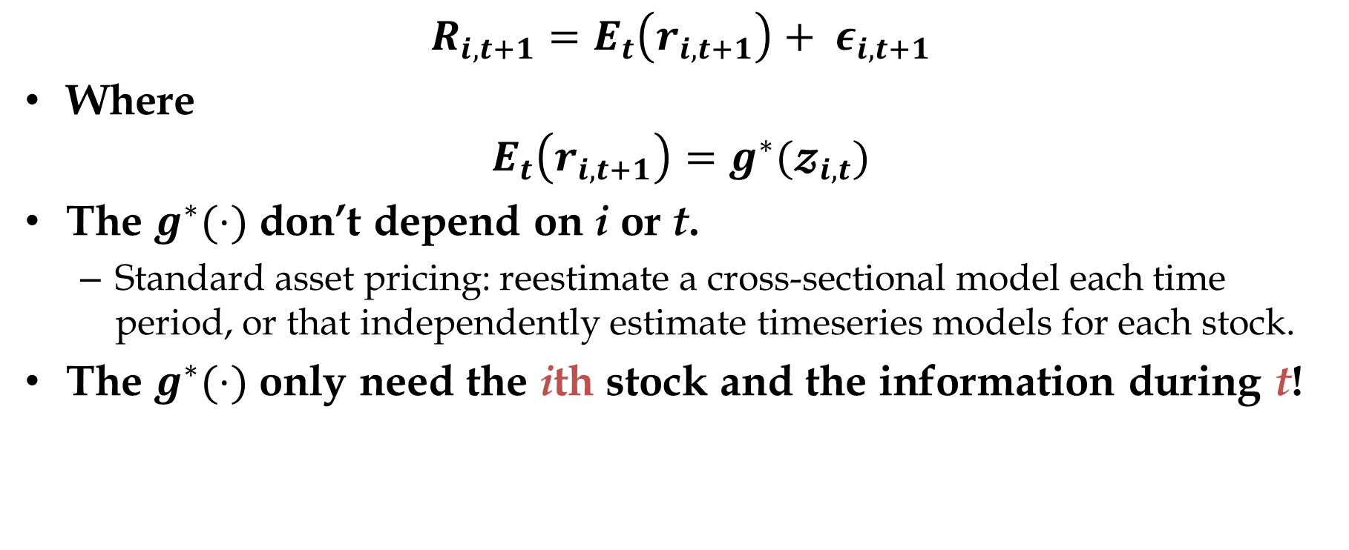
Empirical analysis: framework
$$R_{i,t+1}=E_{t}\left(r_{i,t+1}\right)+ ε_{i,t+1}$$
Where
$$E_{t}\left(r_{i,t+1}\right)=g^{∗}(𝔃_{i,t})$$
The $g^{∗}(⋅)$ don’t depend on i or t.
Standard asset pricing: reestimate a cross-sectional model each time period, or that independently estimate timeseries models for each stock.
The $g^{∗}(⋅)$ only need the ith stock and the information during t!

Slide 5
Empirical analysis: framework
Data
Observation: nearly 30,000 individual stocks from CRSP listed in NYSE, AMEX, and NASDAQ.
Sample period: over 60 years from Mar 1957 to Dec 2016.
Predictor set: 94 characteristics for each stock, interactions of each characteristic with 8 macroeconomic predicators, and 74 industry sector dummy variables, totaling more than 900 baseline signals.
Models
OLS, OLS-3(size, book-to-market, and momentum), PLS, PCR, elastic net(ENet), generalized linear model with group lasso(GLM), random forest(RF), gradient boosted regression trees(GBRT), and neural network with 1-5 layers(NN1,…,NN5).
Tunning and prediction
Training set: 18 years (1957-1974), and then expending one year by one year.
Validation set: 12 years (1975-1986), and then rolling one year by one year.
Testing set: 30 years (1987-2016).
Not cross-validate to maintain the temporal ordering of the data.

Slide 6
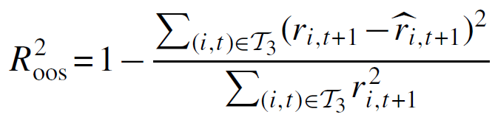
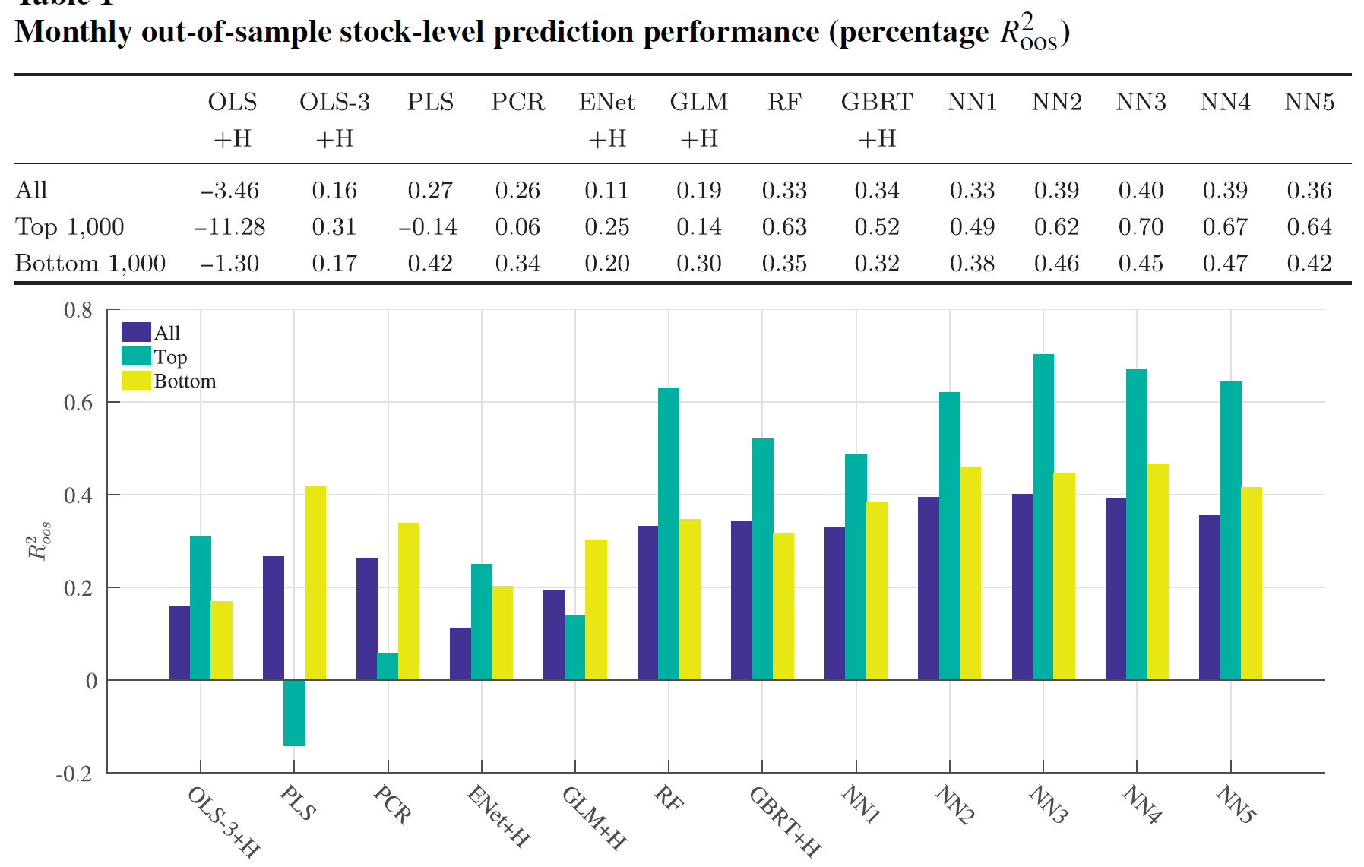
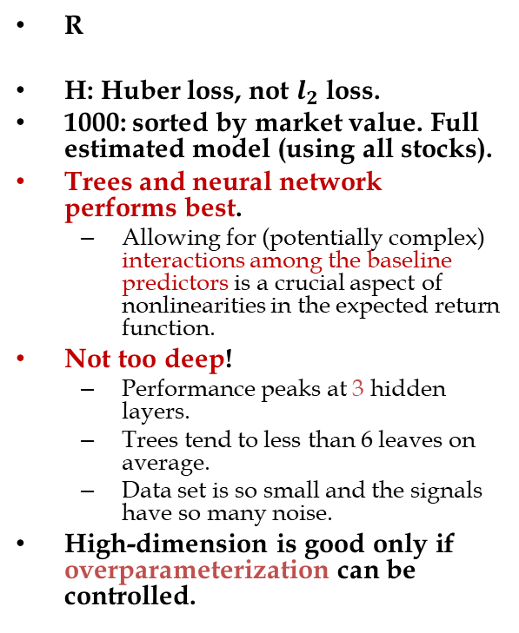
Empirical analysis: prediction performance (monthly)
R
H: Huber loss, not $l_{2}$ loss.
1000: sorted by market value. Full estimated model (using all stocks).
Trees and neural network performs best.
Allowing for (potentially complex) interactions among the baseline predictors is a crucial aspect of nonlinearities in the expected return function.
Not too deep!
Performance peaks at 3 hidden layers.
Trees tend to less than 6 leaves on average.
Data set is so small and the signals have so many noise.
High-dimension is good only if overparameterization can be controlled.

Slide 7
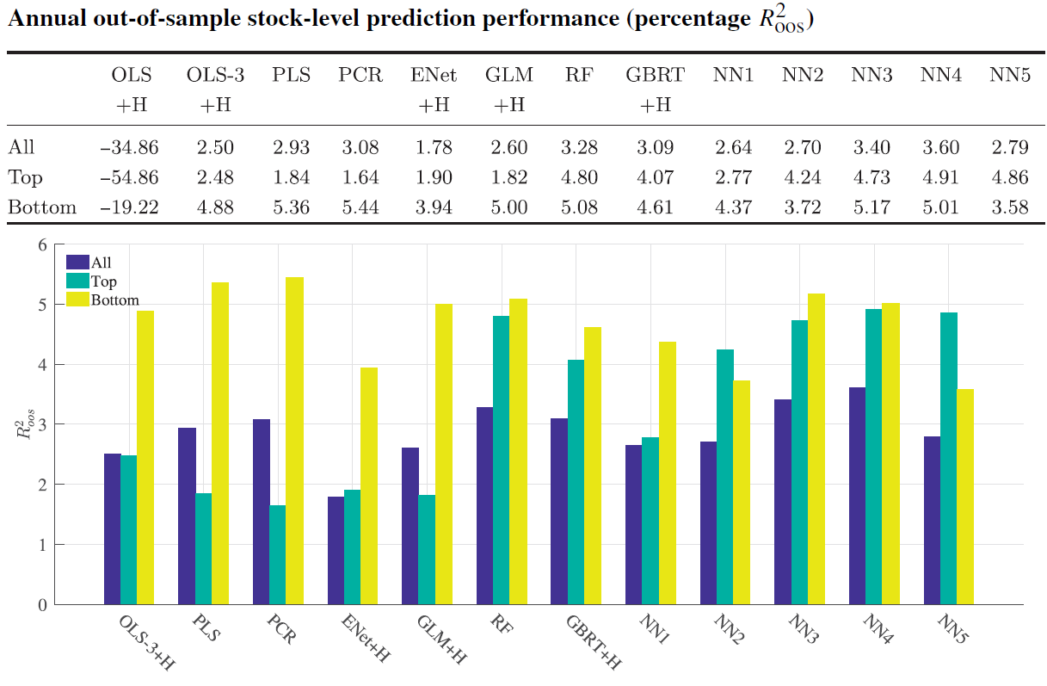
Empirical analysis: prediction performance (annual)
Similar to the monthly results?
Larger magnitude.
Differences are smaller (exclude OLS+H).
Trees and neural network perform better in the top subsample.
OLS, PLS,PCR,GLM and Enet perform well in the bottom subsample.
My guess:
Interactions among the baseline predictors are weaker in the annual aspect.
Top have more interactions?

Slide 8
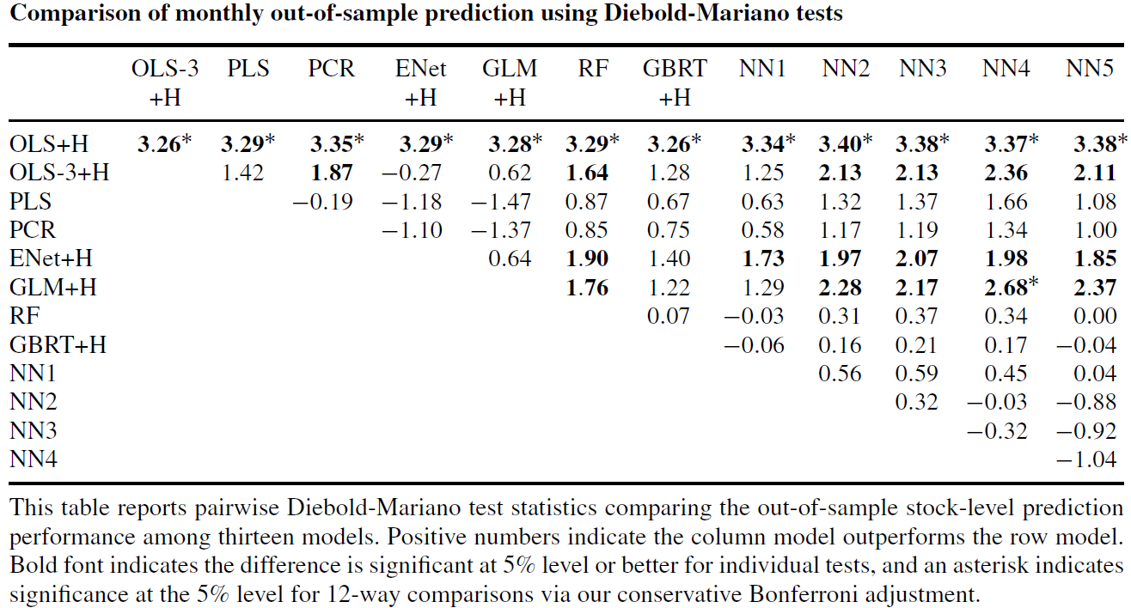
Empirical analysis: model comparison
Table explanation:
Col vs row (positive means outperform).
Bold means significant at 5% level.
* means significant via Bonferroni adjustment (control FWER, reducing type I error).
Conclusions
Constrained linear models outperform the unconstrained models.
Penalized linear models have little difference with dimension reduction models.
Trees a little bit outperform linear models.
Neural networks are good!!!

Slide 9
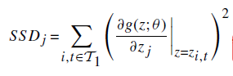
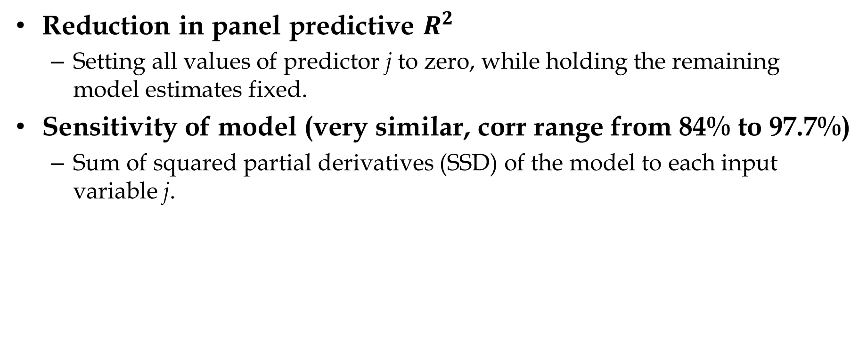
Empirical analysis: variable importance
Reduction in panel predictive $R^{2}$
Setting all values of predictor j to zero, while holding the remaining model estimates fixed.
Sensitivity of model (very similar, corr range from 84% to 97.7%)
Sum of squared partial derivatives (SSD) of the model to each input variable j.

Slide 10
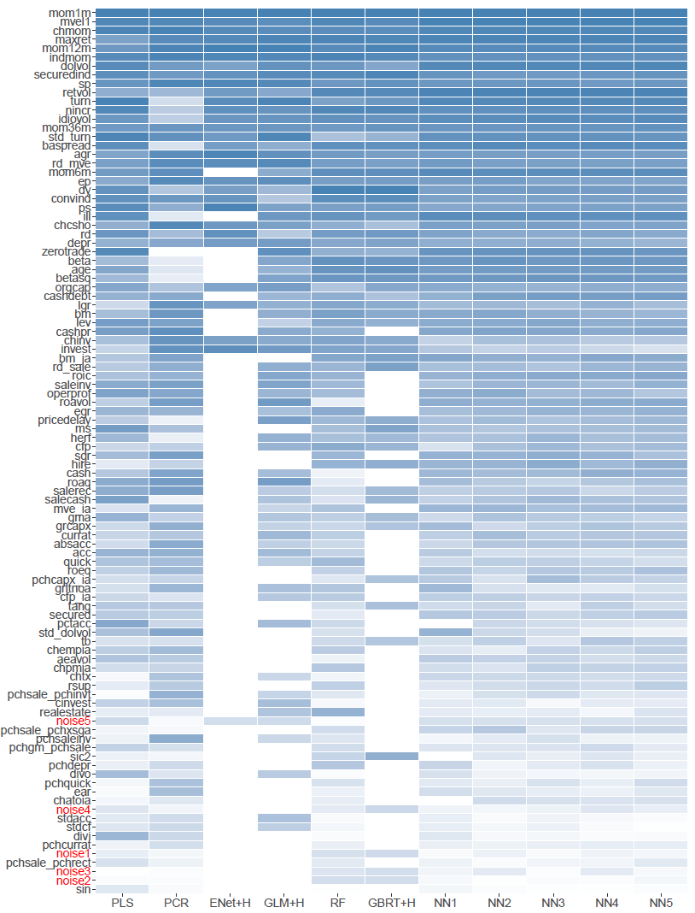
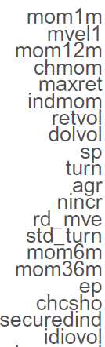
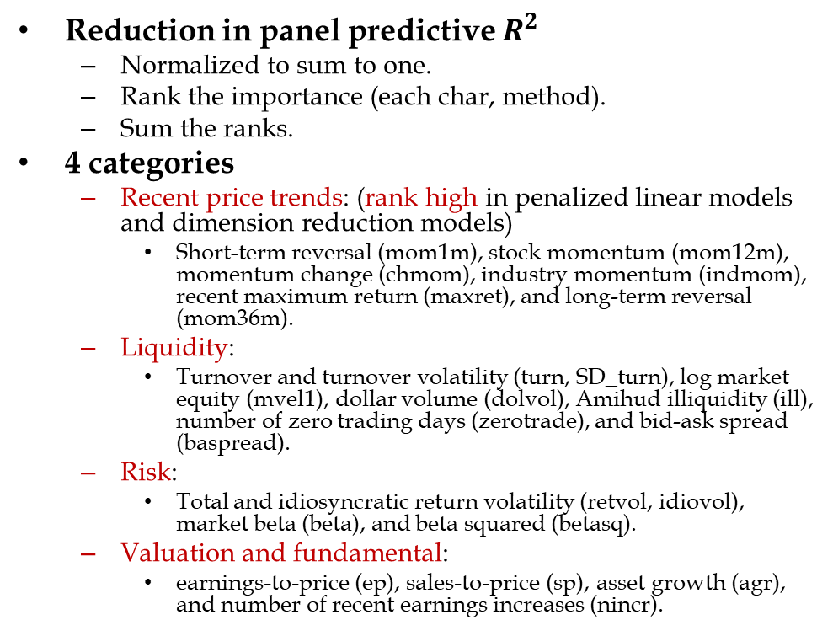
Empirical analysis: variable importance
Top 20
Reduction in panel predictive $R^{2}$
Normalized to sum to one.
Rank the importance (each char, method).
Sum the ranks.
4 categories
Recent price trends: (rank high in penalized linear models and dimension reduction models)
Short-term reversal (mom1m), stock momentum (mom12m), momentum change (chmom), industry momentum (indmom), recent maximum return (maxret), and long-term reversal (mom36m).
Liquidity:
Turnover and turnover volatility (turn, SD_turn), log market equity (mvel1), dollar volume (dolvol), Amihud illiquidity (ill), number of zero trading days (zerotrade), and bid-ask spread (baspread).
Risk:
Total and idiosyncratic return volatility (retvol, idiovol), market beta (beta), and beta squared (betasq).
Valuation and fundamental:
earnings-to-price (ep), sales-to-price (sp), asset growth (agr), and number of recent earnings increases (nincr).

Slide 11
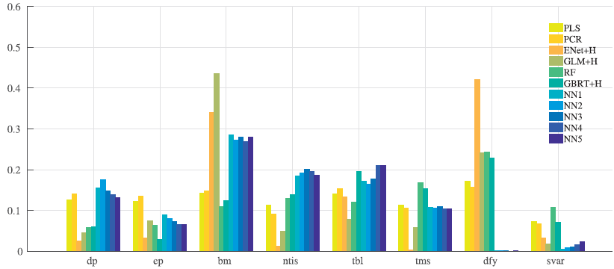
Empirical analysis: variable importance (macro)
8 macroeconomic predictors:
Dividend-price ratio (dp), earnings-price ratio (ep), book-to-market ratio (bm), net equity expansion (ntis), Treasury-bill rate (tbl), term spread (tms), default spread (dfy), and stock variance (svar).
Book-to-market ratio is a critical predictor.
Market volatility has little row.
Nonlinear methods (trees and neural networks) place great emphasis on exactly those predictors ignored by linear methods, such as term spreads and issuance activity (dp, ntis).

Slide 12
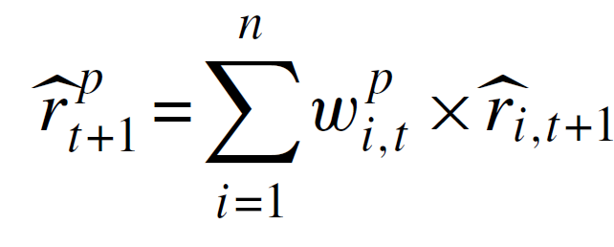
Empirical analysis: portfolio forecasts
Economic contribution: beyond statistical results
Forecast the return of the portfolio out of sample.
Nonlinear models excel in predictive performance and sharpe ratio.

Slide 13
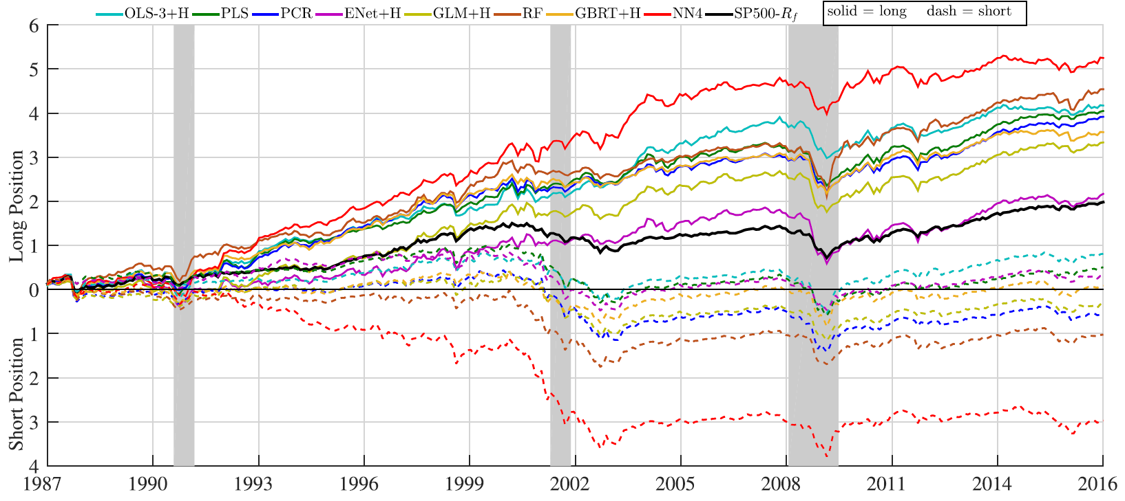
Empirical analysis: build up a portfolio
Bulid-up method:
Predict stocks’ next-month return.
Sort stocks by expected returns into deciles.
Reconstitute portfolios using value weights each month.
Buy the highest expected return stocks (decile 10) and sell the lowest (decile 1).
Conclusions:
NN4 dominates the other models with a H-L SR of 1.35.
Mix not good.

Slide 14
Conclusion
Machine learning methods can help improve empirical understanding of asset prices.
Trees and neural network models perform best due to allowing nonlinear predictor interactions.
All methods agree that variations on momentum, liquidity and volatility are dominant predictive signals.

Slide 15
Thank you for listening. Your comments are welcome.

Slide 16
Addition: predictor set
8 macroeconomic predictors
Dividend-price ratio (dp), earnings-price ratio (ep), book-to-market ratio (bm), net equity expansion (ntis), Treasury-bill rate (tbl), term spread (tms), default spread (dfy), and stock variance (svar).
94 characteristics predictors
Annual 61;
Quarterly 13;
Monthly 20.

Slide 17
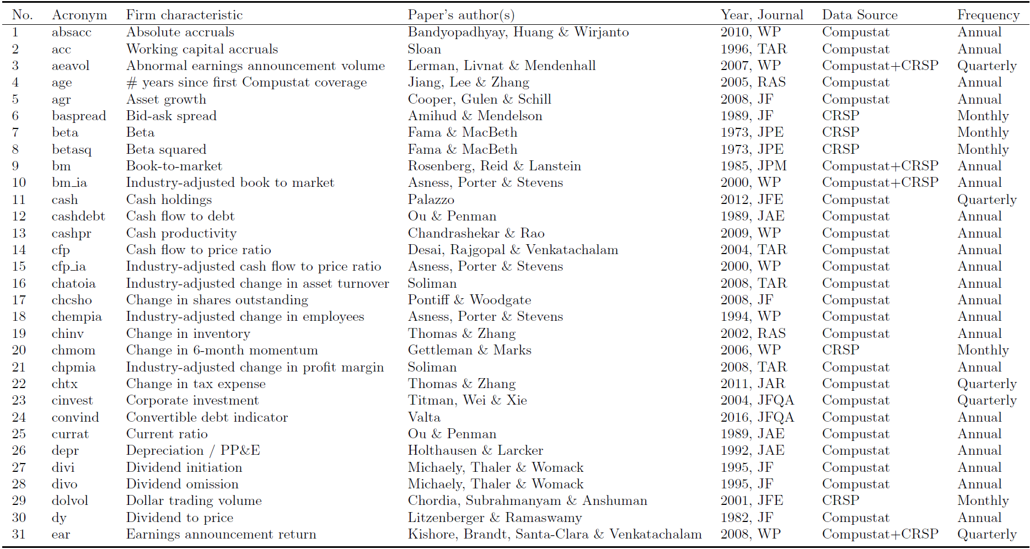
Addition: predictor set

Slide 18
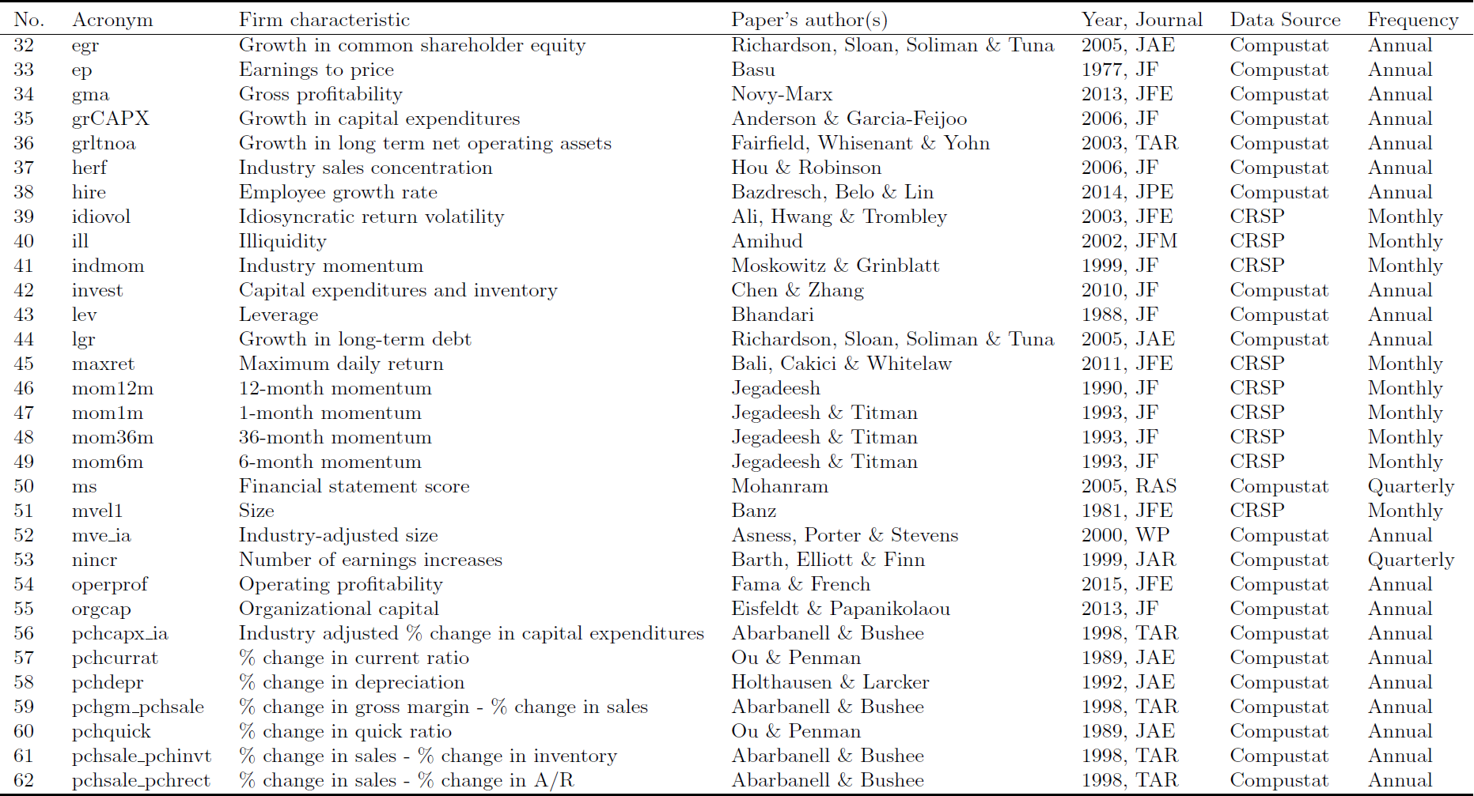
Addition: predictor set

Slide 19
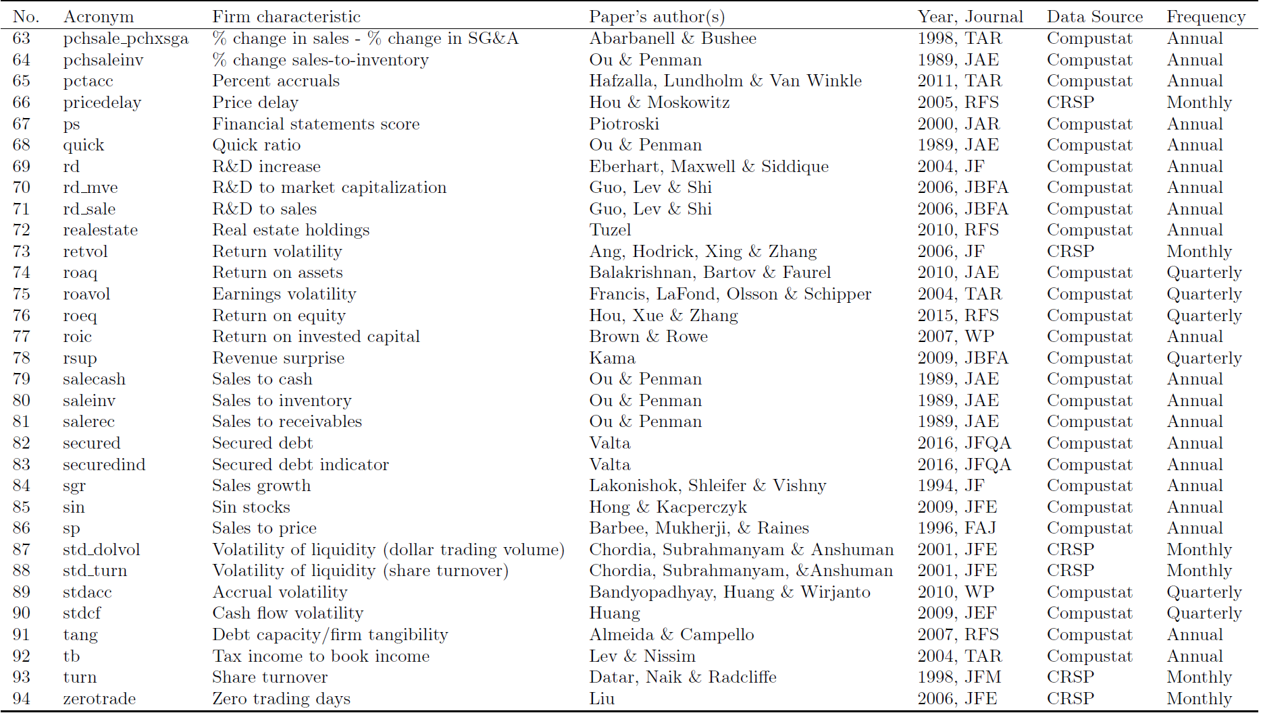
Addition: predictor set

Slide 20
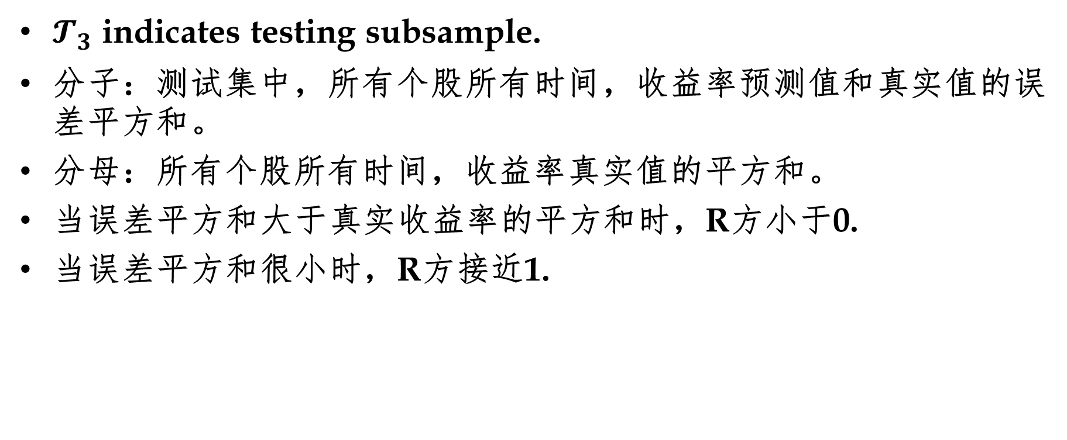

Addition: out-of-sample $R^{2}$
$𝓣_{3}$ indicates testing subsample.
分子：测试集中，所有个股所有时间，收益率预测值和真实值的误差平方和。
分母：所有个股所有时间，收益率真实值的平方和。
当误差平方和大于真实收益率的平方和时，R方小于0.
当误差平方和很小时，R方接近1.

